Slide 1
Project Bridge - Central
August and YTD Data
Host : Maria Weber: Quality Specialist
Webex Information Included in Invitation

Slide 2
Central Florida Data Packet
August 2020
Performance Measures
Timeliness of Admission
YTD Success Rate
YTD Discharge Analysis
YTD Length of Stay
YTD Census Summary
O.D.S and Recidivism
Vocational Certifications
Pre-Employment
Employment
Current Education Enrollment
GED Tests Passed
Education Gains
Project 180
Mentoring Active Clients
Caseload Per TC
Staff Vacancies

Slide 3
Performance Measures
July 1, 2020 – August 31, 2020
 | Output Measure | Numerator / | / Denominator | Performance | Minimum Standard | Goal Achieved?
1 | Youth referred to Vocational Certification will obtain a certificate. HBI and EWF | 19 | 21 | 90.48% | 80.00% | YES
2 | Youth receiving services shall not be arrested for a new violation, and subsequently, adjudicated during services. No recidivism during services | 234 | 258 | 90.70% | 80.00% | YES
3 | Youths admitted for services, shall successfully complete the goals that were identified in the Service Plan. (Blue: Successful vs. Inactives (Green: Successful vs. Non-Successful) | 33 | 58 | 56.90% | 85.00% | NO
 |  | 33 | 35 | 94.28% | 85.00% | YES
4 | Youth identified to be employed on their ISP will be matched with employment. HBI and EWF | 11 | 12 | 91.67% | 80.00% | YES
5 | Recidivism: Youth receiving services shall not be arrested for a new violation, and subsequently, adjudicated one (1) year after release from the program. | 29 | 39 | 74.36% | 85.00% | NO

Slide 4
Timeliness of Admission and Assessments
July 1, 2020 – August 31, 2020

Slide 5
YTD Success Rate
July 1, 2020 to August 31, 2020
Circuit | Program Successfully Completed | Inactives | YTD Success Rates
6 (Pasco) | 1 | 10 | 1 / 11 = 0.09%
9 (Orange) | 10 | 3 | 10 / 13 = 76.92%
10 (Polk) | 10 | 4 | 10 / 14 = 71.43%
12 (Manatee) | 5 | 2 | 5 / 7 = 71.43%
13 (Hillsborough) | 5 | 4 | 5 / 9 = 55.56%
18 (Brevard) | 2 | 2 | 2 / 4 = 50.00%
TOTAL | 33 | 25 | 33 / 58 = 56.90%

Slide 6
YTD Discharge Analysis
July 1, 2020 – August 31, 2020

Slide 7
YTD Length Of Stay
July 1, 2020 – August 31, 2020

Slide 8
YTD Census Summary
July 1, 2020 – August 31, 2020

Slide 9
Offense During Services
July 1, 2020 – August 31, 2020

Slide 10
Recidivism
July 1, 2020 – August 31, 2020

Slide 11
Vocational Certifications
July 1, 2020 – August 31, 2020

Slide 12
Pre-Employment
July 1, 2020 – August 31, 2020

Slide 13
Employment
July 1, 2020 – August 31, 2020
.

Slide 14
Education Enrollment
July 1, 2020 – August 31, 2020

Slide 15
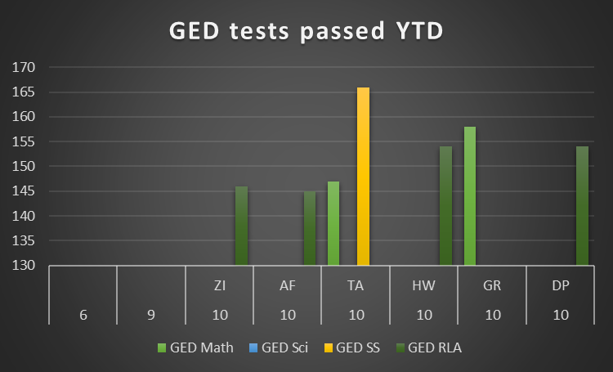
GED Test Passed
July 1, 2020 – August 31, 2020

Slide 16
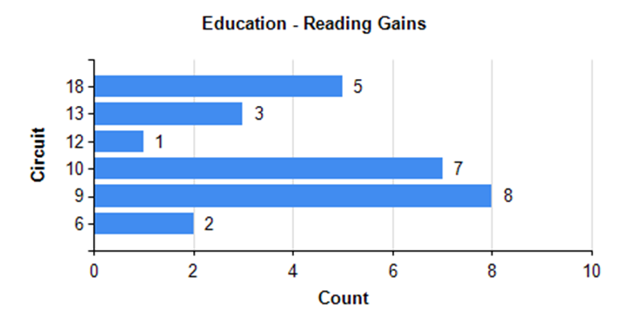
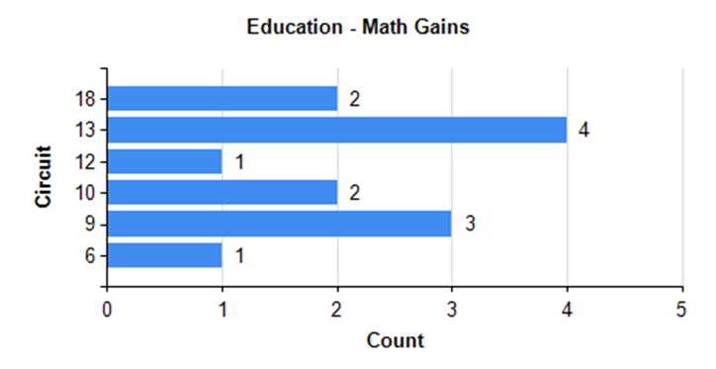
YTD Gains
July 1, 2020-August 31, 2020

Slide 17
Mentoring – Active
July 1, 2020 to August 31, 2020
.
17

Slide 18
Project 180
July 1, 2020 – August 31, 2020

Slide 19
Caseload
As of August 31, 2020
Eckerd Staff | Current Caseload
Ballard, Samara | 7
Eubanks, Marileen | 12
Gentle, Cameron | 14
Hand, Derrell | 15
Hood, Megan | 18
Hunt, Lawrence | 16
Jolly, Marquis | 5
Lopez, Loren | 16
Love, Aaron | 14
Malolos, Carlo | 13
Mouzon, Marvin | 15
Stanley, Deborah | 14
West, Bernadine | 3
Total | 162

Slide 20
Staff Vacancies
 | Budgeted Position | Circuits | Name | Date of Hire | Date of Vacancy | # of Days Vacant
1 | Transition Director | Central | Curtis Campogni | 11/3/2013
2 | Program Manager | 9, 18 | Melvin Guzman | 12/14/2015
3 | Program Manager | 6, 13 | Marvin Mouzon | 7/1/2013
4 | Program Manager | 10, 12 | Alysia Franks | 3/14/2014
5 | Pre-Service Coordinator | East | Bernadine West | 5/29/2014
6 | Pre-Service Coordinator | West | Jaime Grubbs | 3/9/2020
7 | Transition Coordinator | 6 | Loren Lopez | 12/3/2018
8 | Transition Coordinator | 6 | Aaron Love | 3/12/2018
9 | Transitoin Coordinator | 9 | Megan Hood | 10/24/2017
10 | Transition Coordinator | 9 | Bryon Brown | 6/8/2020
11 | Transition Coordinator | 10 | Lawrence Hunt | 11/1/2013
12 | Transition Coordinator | 10 | Deborah Stanley | 2/1/2020
13 | Transition Coordinator | 12 | Cameron Gentle | 10/14/2019
14 | Transition Coordinator | 13 | Alicia Kinder-Wimbley | 6/15/2020
15 | Transition Support Spec | 13 | Tatiana Hernandez | 6/22/2020
16 | Transition Coordinator | 18 | Marileen Eubanks | 8/1/2014
17 | Transition Supervisor | 9, 18 | Derrell Hand | 1/29/2015
18 | Transition Supervisor | 6, 13 | Carlos Malolos | 12/26/2017
19 | Transition Supervisor | 10, 12 | Samara Ballard | 2/1/2020
20 | Restorative Justice Specialist | Regional | Marquis Jolly | 5/23/2019
21 | Transportation Support Spec | 9 | Sheena Hernandez | 5/1/2016
22 | Transportation Support Spec | 9 | Jabour Williams | 3/21/2018

Slide 21
Staff Vacancies Cont.

Slide 22
Staff Vacancies Cont

Slide 23
Thank you so much for your Attention and Participation.
Have a Great Day!
Eckerd Connects Project Bridge
FY 19-20

